Slide 1

EE-371 : Control Systems
Lecture#28,29
ROOT LOCUS TECHNIQUES (A Graphical Tool)
8.1 Introduction
8.2 Defining the Root Locus
8.3: Sketching the Root Locus
Textbook: Chapter # 07 (5th edition)
Textbook: Chapter # 08 (5th edition)
Text Book: Control Systems Engineering by Norman S. Nise 5th Edition
Instructor: Ms Neelma Naz
Class: BEE 12 C/D
School of Electrical Engineering and Computer Science
Department of Electrical Engineering

Slide 2
Textbook: Chapter # 08 (5th edition)
ROOT LOCUS
Technique

Slide 3
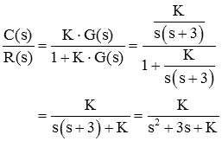




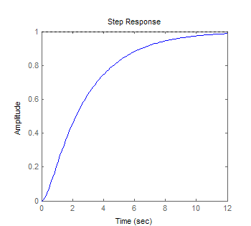
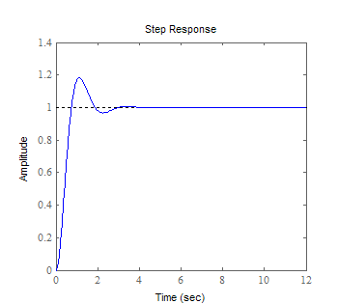
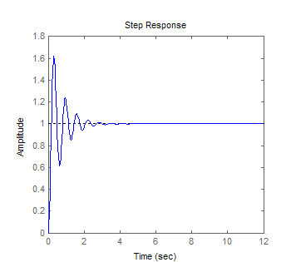
Variation of system performance with changes in parameter K
For K = 1
For K = 10
For K = 100

Slide 4
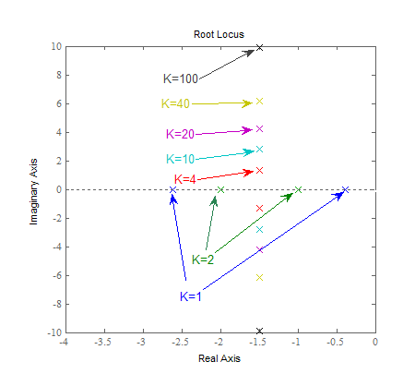

Slide 5
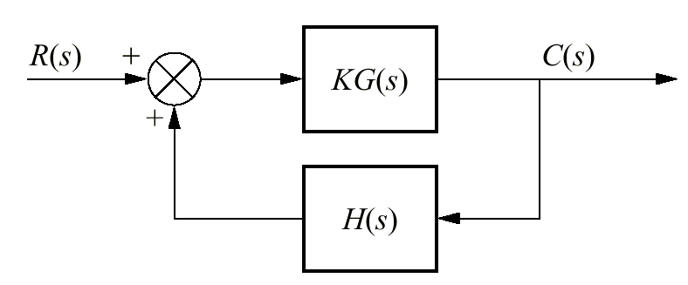

Definition
The closed-loop poles of the feedback control system:
-
are the roots of the characteristic equations:
The root locus is the path of the poles traced out in the s-plane as a system parameter varies from zero to infinity

Slide 6
Introduction
Root locus is a graphical representation of the closed-loop poles as a system parameter is varied.
Provides a qualitative description of systems performance.
Provides solution for systems of order higher than two.
Provide a graphical representation of system’s stability.
Two concepts that will be reviewed beforehand:
  Control system problem
  Complex numbers representation as vectors

Slide 7
The Control System Problem

Slide 8
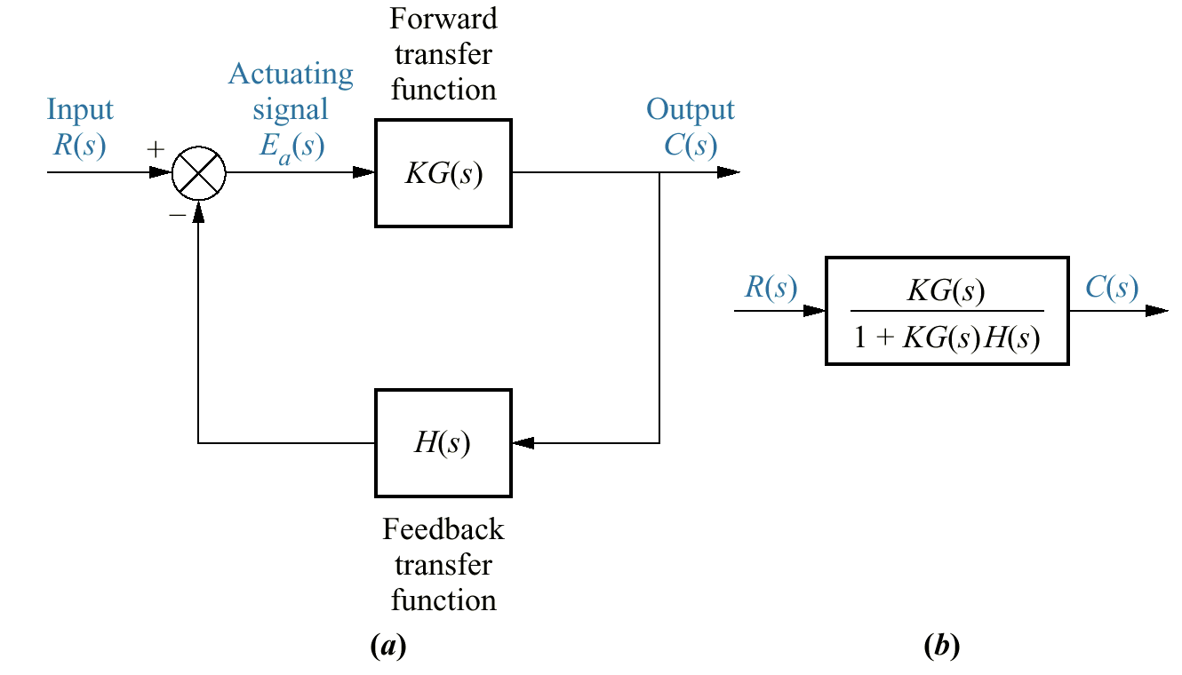
The open-loop transfer function is defined as KG(s)H(s)
Poles of the ‘KG(s)H(s)’ are easily found, since these poles arise from simple cascaded first- or second-order subsystems
Variations in K do not affect the location of any pole of this function
Poles of the closed-loop transfer function, T(s) = KG(s)/[l + KG{s)H(s)], are difficult to find
(Require factoring the closed-loop system's characteristic polynomial)
The closed-loop poles change with changes in system gain K

Slide 9
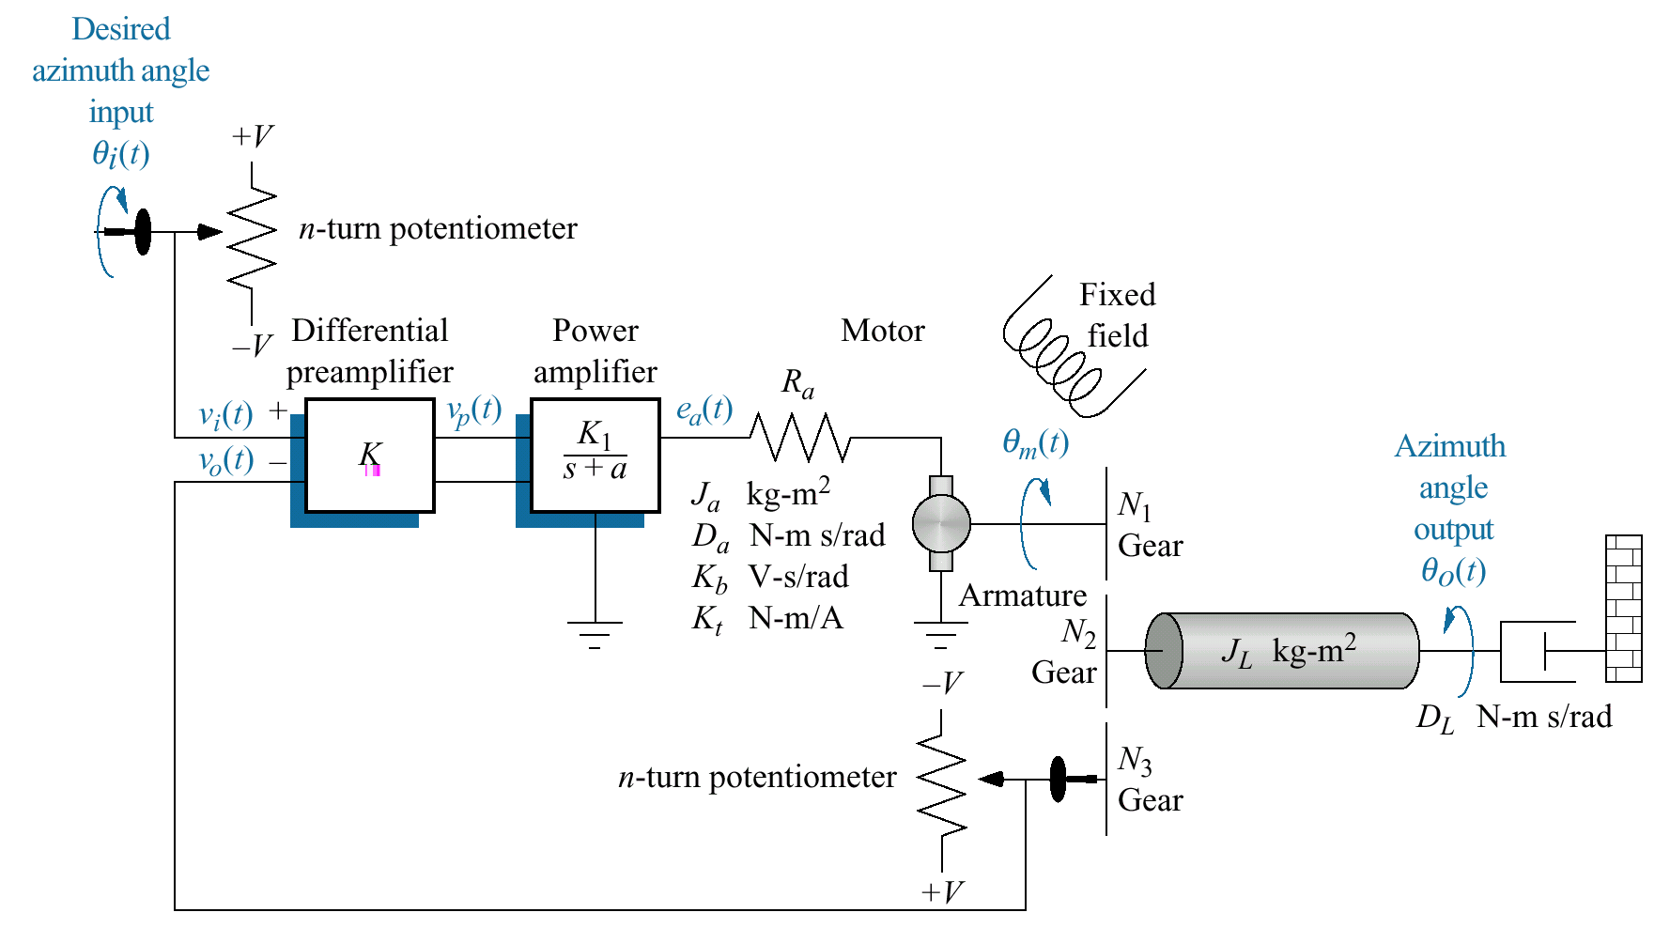
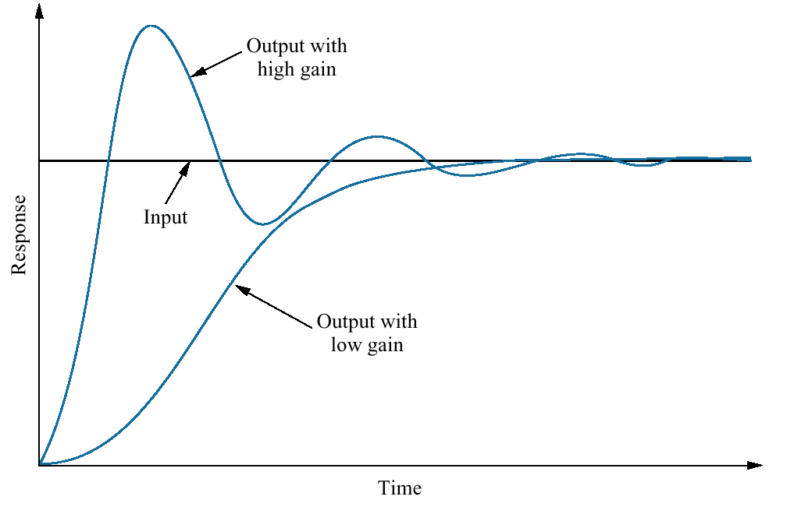
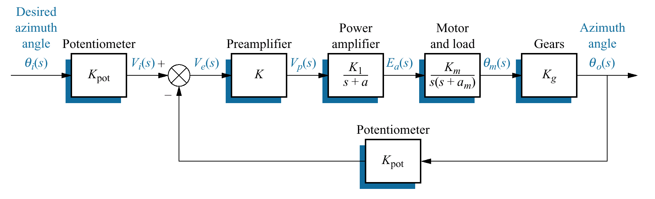
Antenna Azimuth Position Control System

Slide 10
θ_{i}(s)
θ_{o}(s)
G(s)
G(s) = K_{p}KK₁K_{m}K_{g}/(s(s+a_{m})(s+a)+ K_{p}KK₁K_{m}K_{g})

Slide 11
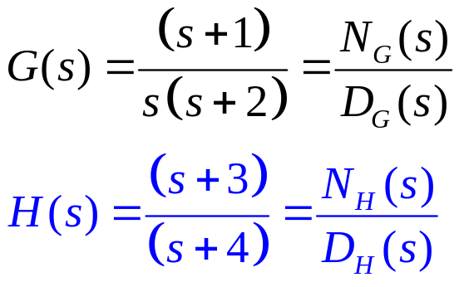
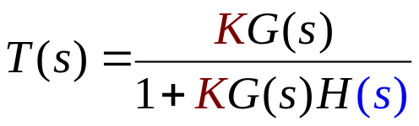
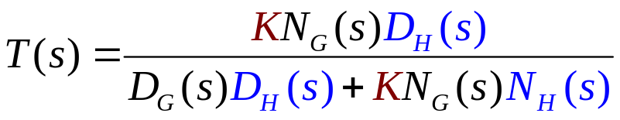
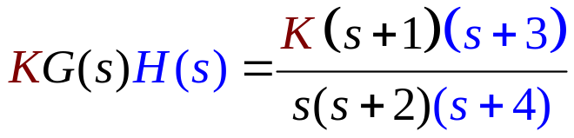
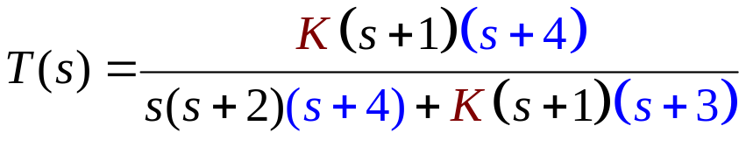
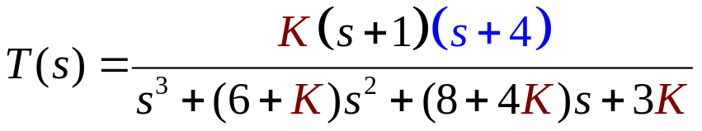
Closed loop TF
Open loop TF
The poles of KG(s)H(s) are:
0, -2, and -4
The zeros of KG(s)H(s) are:
- 1 and - 3
The poles of T(s) are not immediately known and are dependent on K

Slide 12
Vector Representation of Complex Numbers

Slide 13
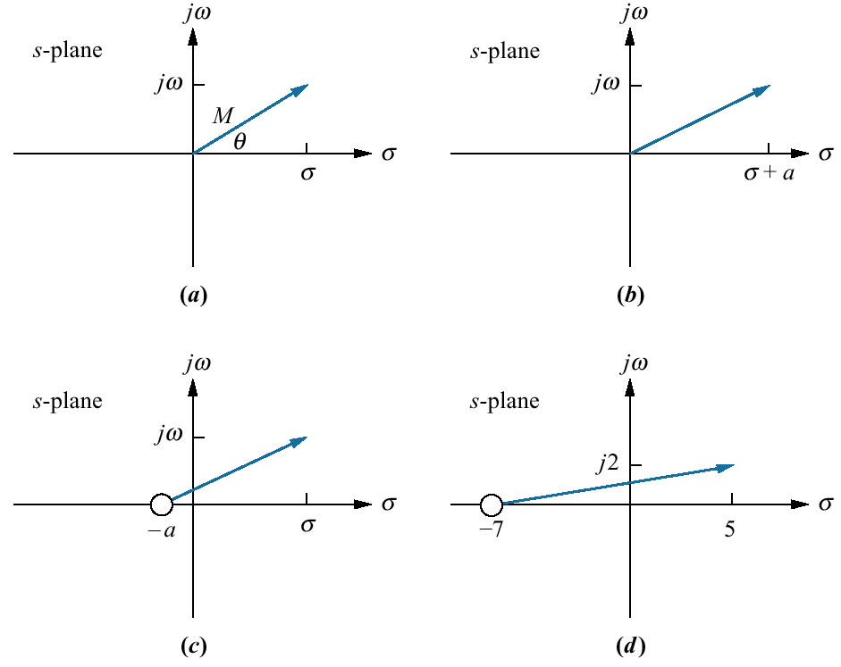
A complex number, s = σ + jω, described in Cartesian coordinates can be graphically represented by a vector
The complex number can also be described in polar form with magnitude M and angle θ.
F(s) = (s + a) {a function of s}
Substituting the complex number
s = σ + jω yields
F(s) = (a + σ) + jω
another complex number (represented by a vector)

Slide 14
F(s) = (s + a), has a zero at -a
Translate the vector ‘a’ units to the left
Alternate representation of the complex number that originates at the zero of F(s) and terminates on the point s = σ + jω

Slide 15
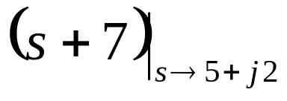
We conclude that (s + a) is a complex number
and
can be represented by a vector drawn from the zero of the function to the point s.
For example,
is a complex number drawn from the zero of the function, -7, to the point s, which is 5 +j2

Slide 16
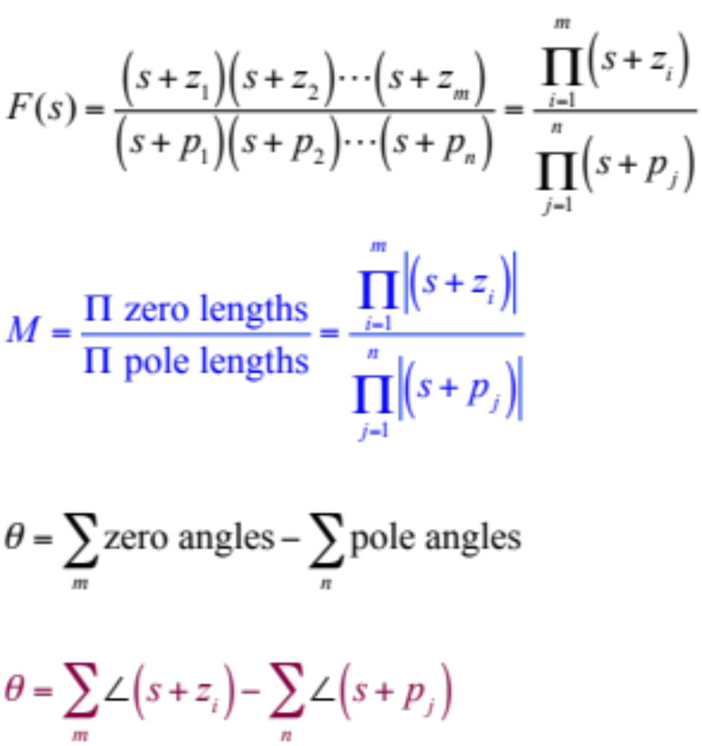
Evaluation of F(s)
|(s +z_{i})| is magnitude of the vector drawn from the zero of F(s) at -z_{i} to the point s
|(s +p_{i})| is magnitude of the vector drawn from the pole of F(s) at -p_{i} to the point s
A zero angle is the angle of a vector drawn from the zero of F(s) at - z , to the point s, measured from the positive real axis.
A pole angle is the angle of a vector drawn from the pole of F(s) at - p , to the point s, measured from the positive real axis.

Slide 17
Assignment
Example 8.1 and Exercise 8.1
Don’t submit

Slide 18
Defining the Root Locus

Slide 19
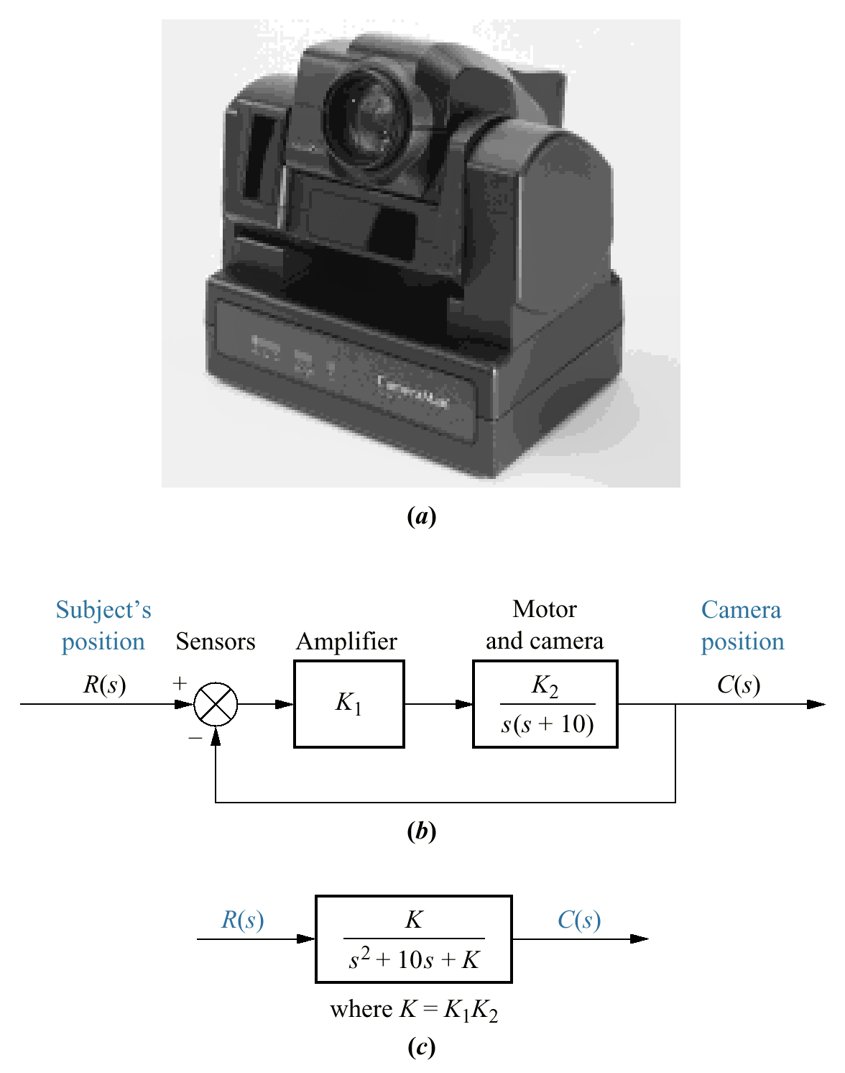
a. Camera System automatically follows a subject
b. block diagram.
c. closed-loop transfer function.

Slide 20
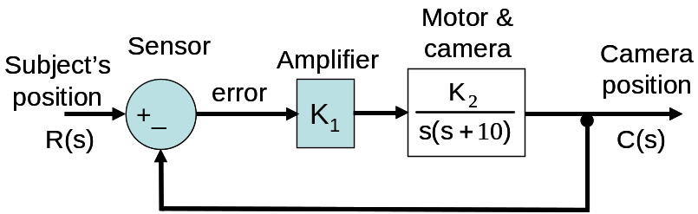
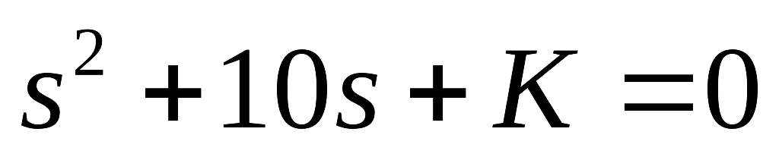
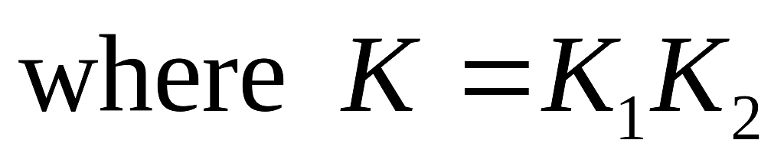
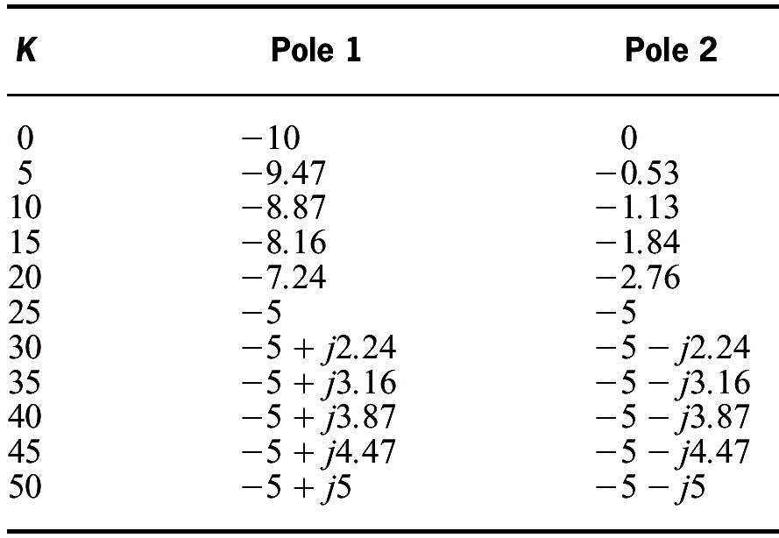
Pole location as a function of gain for the Camera system.

Slide 21
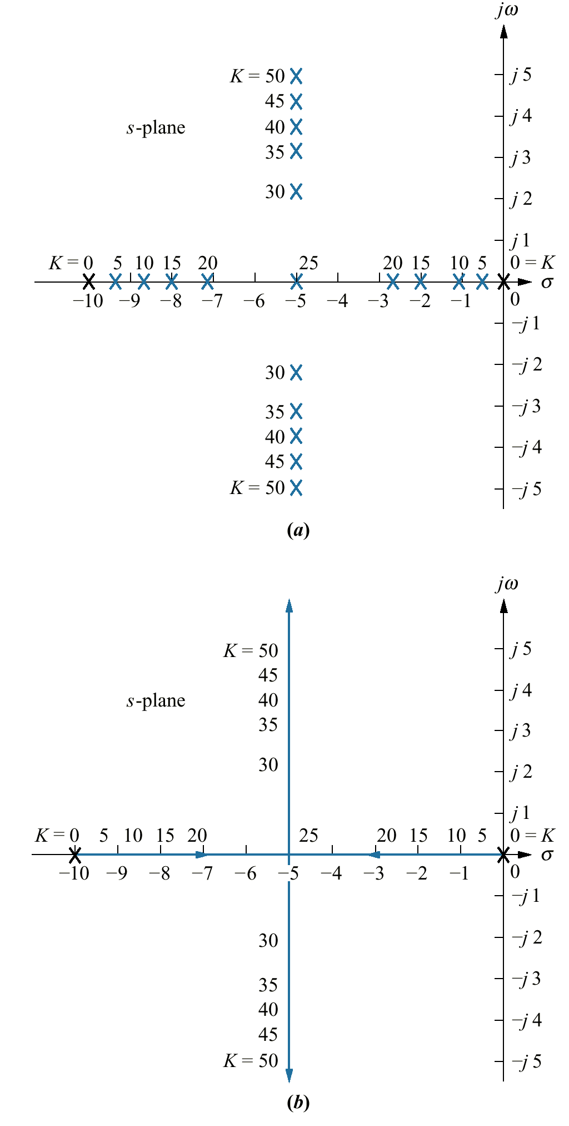
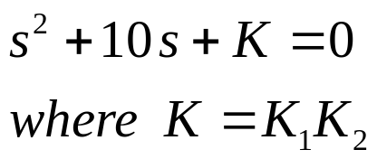
The roots were found by factoring the second-order characteristic polynomial of the transfer function for different values of K
If the polynomial were of tenth or higher order
???

Slide 22
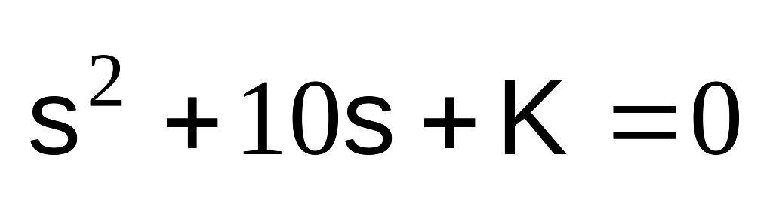
Paths of the poles traced out in the s-plane as the system parameter K is varied from zero to infinity. (i.e. the Root Locus)

Slide 23
Properties of the Root Locus
Facilitates rapid sketch of the root locus for higher-order systems

Slide 24
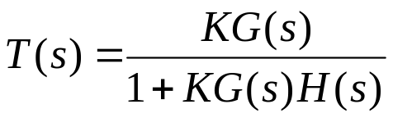




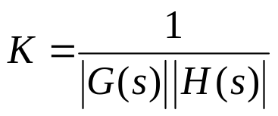

-
and -1 is represented in polar form as
If a value of s is substituted into the function KG(s)H(s), a complex number results. If the angle of the complex number is an odd multiple of 180° , that value of s is a system pole for some particular value of K
A value of s is a closed-loop pole if
Magnitude criterion
Angle criterion

Slide 25

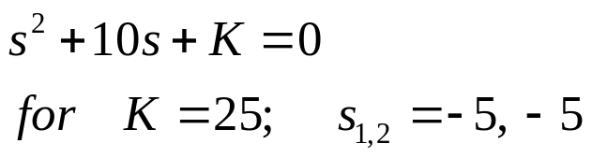
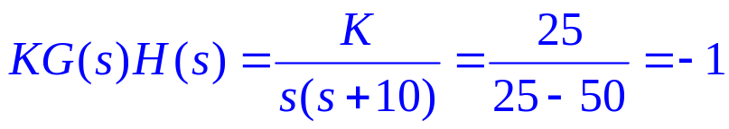
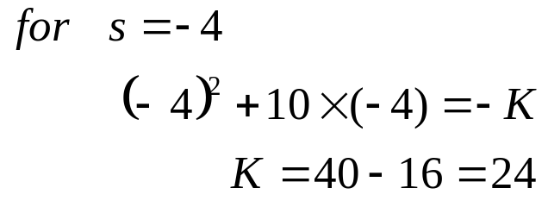
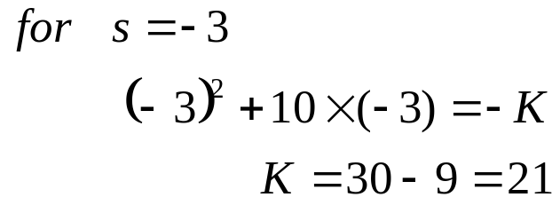

Slide 26
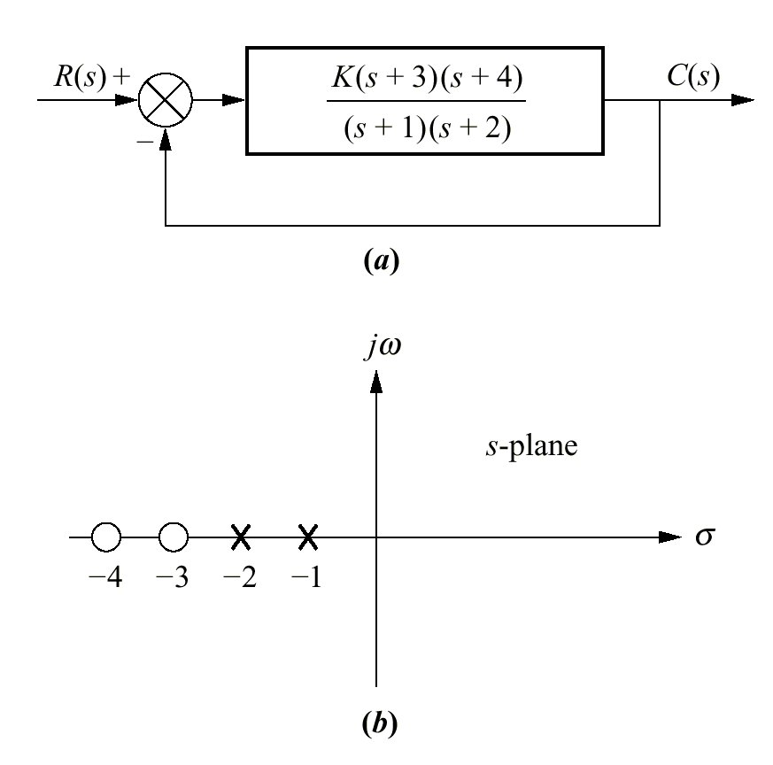



Graphical interpretation of
Applying the complex number concept to system shown in the figure
The closed loop transfer function
If point s is a closed-loop system pole,
it must satisfy the two criteria
pole-zero plot of G (s)

Slide 27
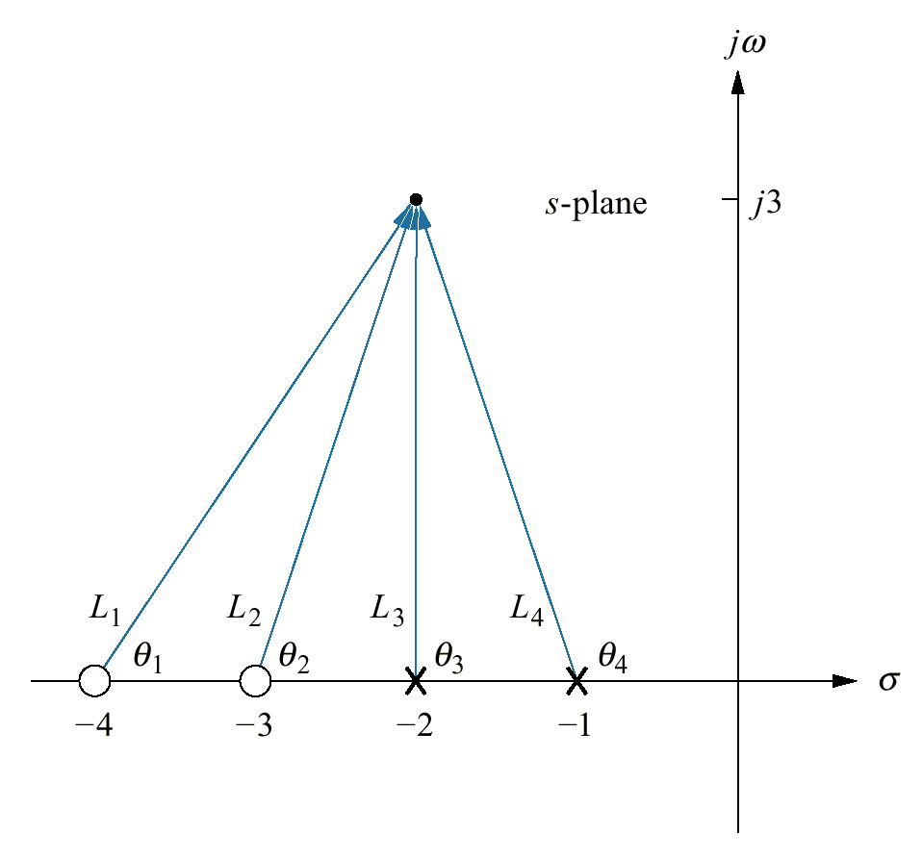
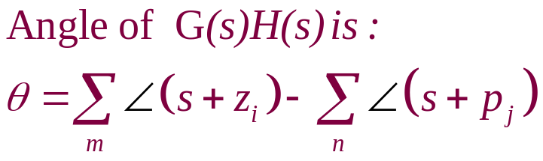
Consider the point -2 + j3 .
If this point is a closed-loop pole, then sum of angles of the zeros – sum of angles of poles must equal an odd multiple of 180°.
Is point (-2+ j3) a point on the root locus ???

Slide 29
Sketching the Root Locus

Slide 30
Some Basic Root Locus Questions
What points are on the root locus?
Where does the root locus start?
Where does the root locus end?
When/where is the root locus on the real axis?
….
….
Answering such questions will help us understand the root locus technique.

Slide 31
Rules for Sketching the Root Locus
1. Number of branches.
The number of branches of the root locus equals the number of closed-loop poles
2. Symmetry.
The root locus is symmetrical about the real axis.

Slide 32
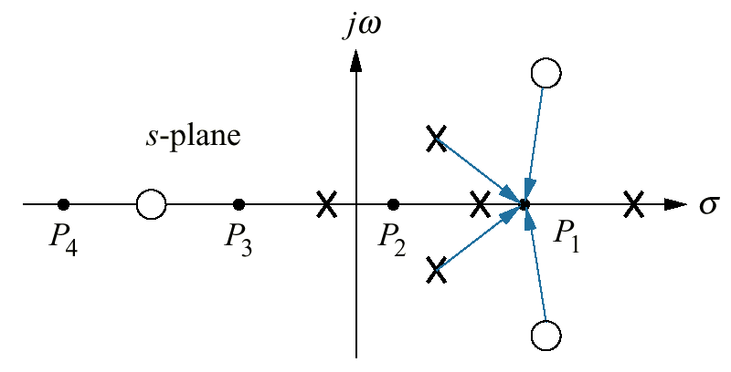

Rules for Sketching the Root Locus
3. Real-axis segments.
On the real axis, for K > O the root locus exists to the left of an odd number finite open-loop poles and/or finite open-loop zeros.
Angle criterion

Slide 33
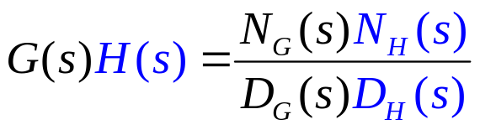
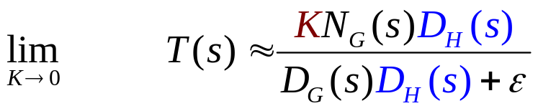
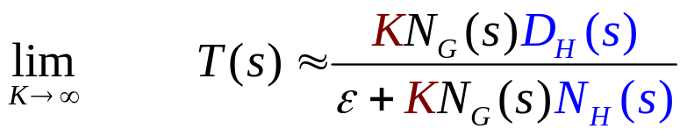
Rules for Sketching the Root Locus
4. Starting and ending points.
The root locus begins at the finite and infinite poles of G(s)H(s) and ends at the finite and infinite zeros of G(s)H(s).
Closed-loop system poles at small gains approach the combined poles of G(s) and H(s)
Closed-loop system poles at large gains approach the combined zeros of G(s) and H(s)

Slide 34
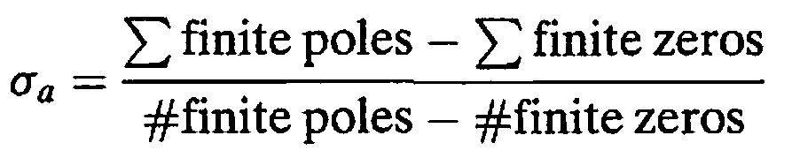
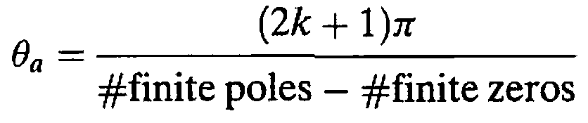
Rules for Sketching the Root Locus
5. Behavior at infinity.
The root locus approaches straight lines as asymptotes as the locus approaches infinity.
The equation of the asymptotes is given by the real-axis intercept σ_{a,} and angle θ_{a} as follows:
where k = 0, ±1 , ±2, ±3 and the angle is given in radians with respect to the positive extension of the real axis.

Slide 35
If the function approaches infinity as s approaches infinity, then the function has a pole at infinity.
G(s) = s has a pole at infinity
If the function approaches zero as s approaches infinity, then the function has a zero at infinity
G(s) = 1/s has a zero at infinity
Every function of s has an equal number of poles and zeros if the finite and infinite poles and zeros are included

Slide 36
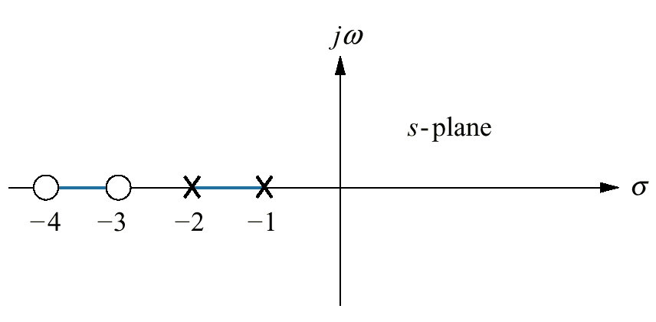
Real-axis segments of the root locus for the
system shown in the figure

Slide 37
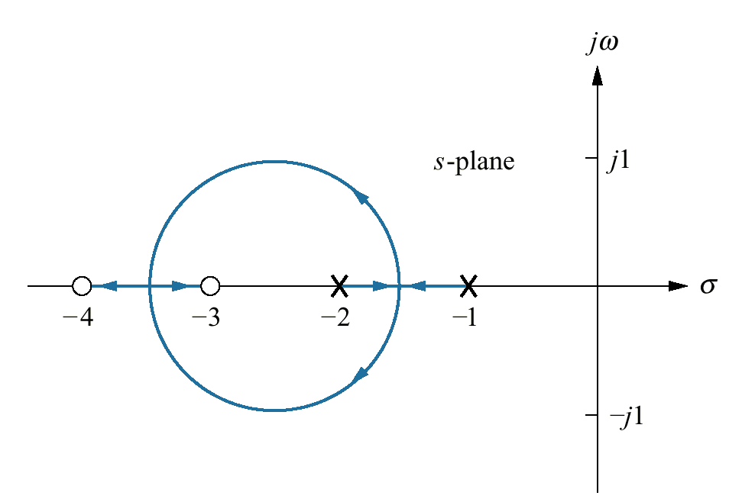
Complete root locus for the system

Slide 38
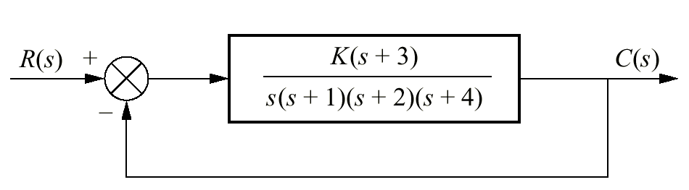
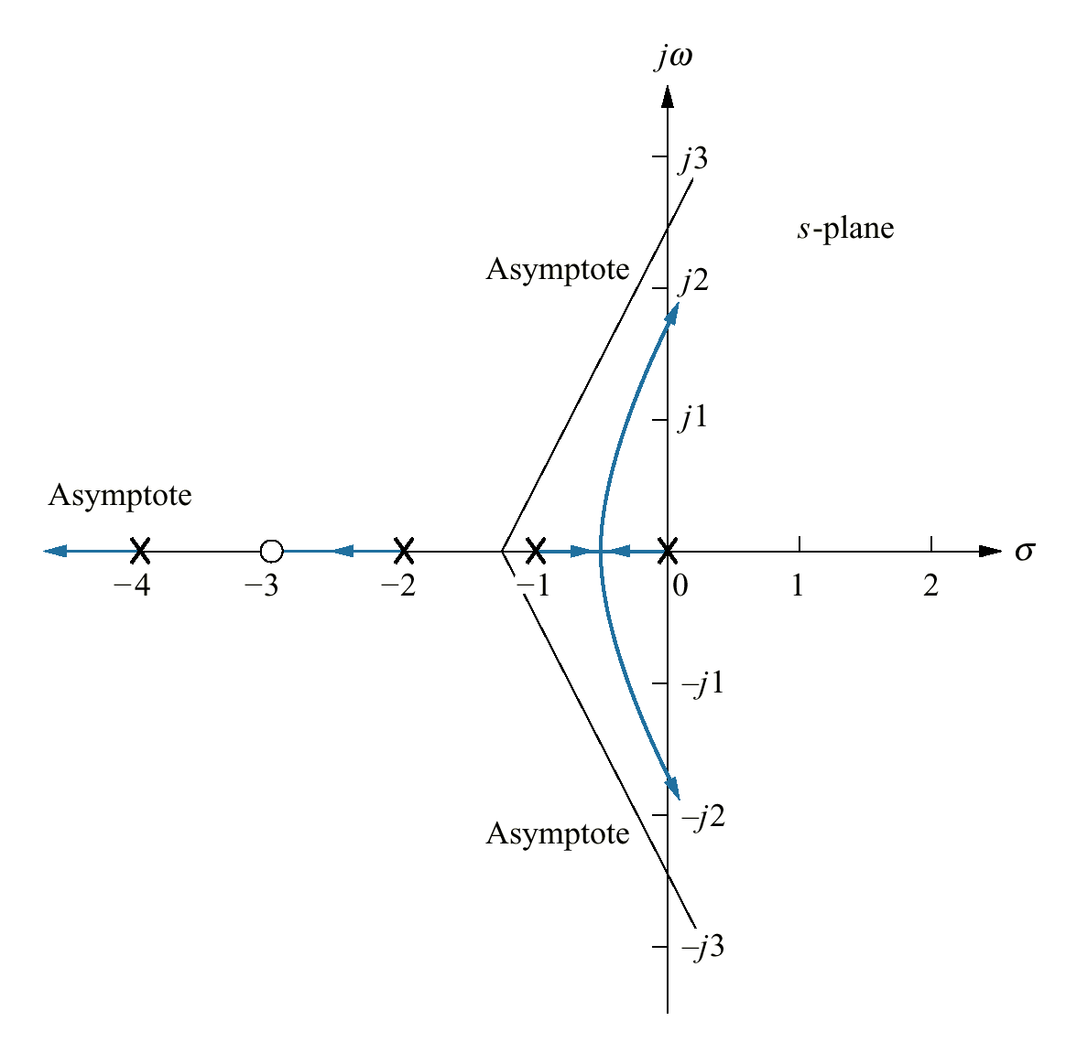
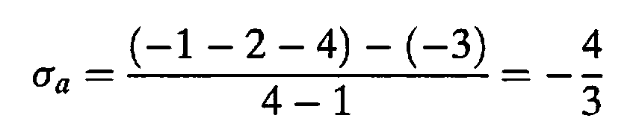
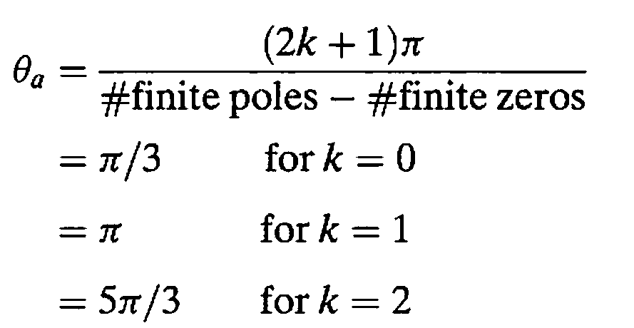
Example 8.2
PROBLEM: Sketch the root locus for the system shown in the Figure.

Slide 39
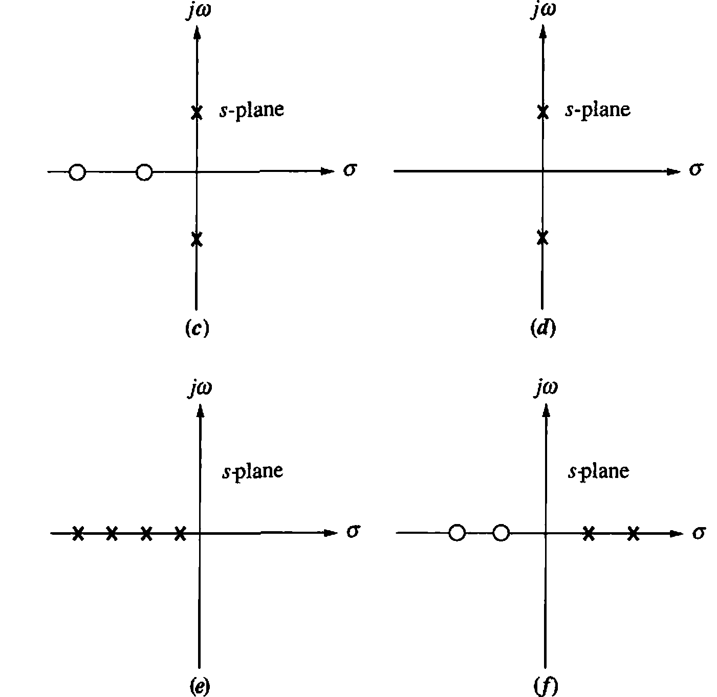
Sketch Root Locus

Slide 40

???

